Slide 2
Deep-Learning based Object Detection
Patrick Buehler
Senior Data Scientist

Slide 3
Agenda
Add your section titles (slide 5, 9, 15, 29, 34)

Slide 4
Session Goals
Show how image classification, image similarity, and object detection using Deep Learning are related.
Provide detailed understanding of Fast R-CNN object detection in the Microsoft Cognitive Toolkit (CNTK).
Present how easy it is to train your own object detector using the provided tutorial.
Illustrate how the trained classifier can be published on Azure as a Rest API.

Slide 5
Challenges for Computer Vision

Slide 6
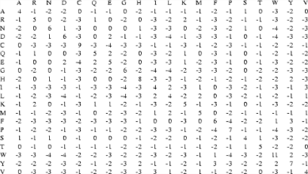
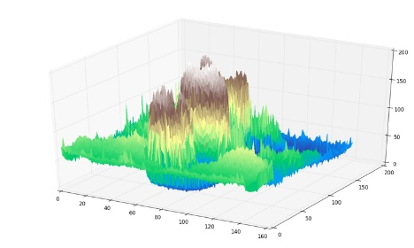
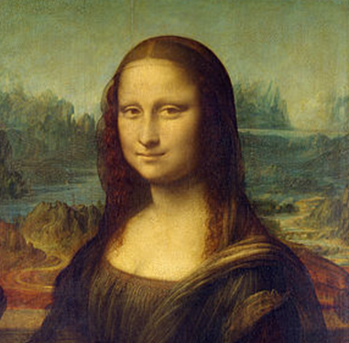
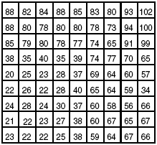
Challenges for Computer Vision
What a computer sees
3D plot of the matrix to the left
What a human sees
Matrix of values in range [0,255]

Slide 7
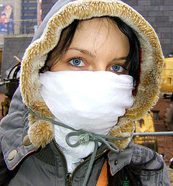
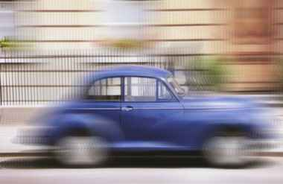

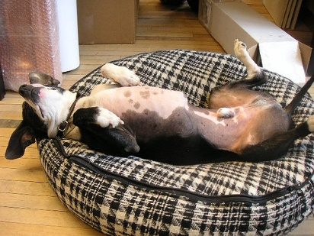
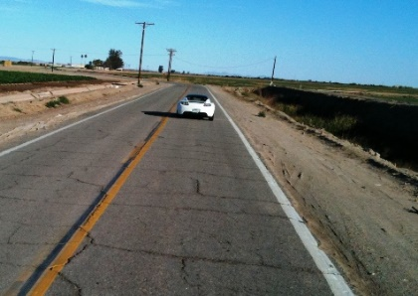
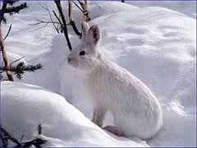

Challenges for Computer Vision
Occlusion
Motion blur
Partial visibility
Within-object appearance variance
Object size
Background similarity
Low-resolution
Bad illumination

Slide 8
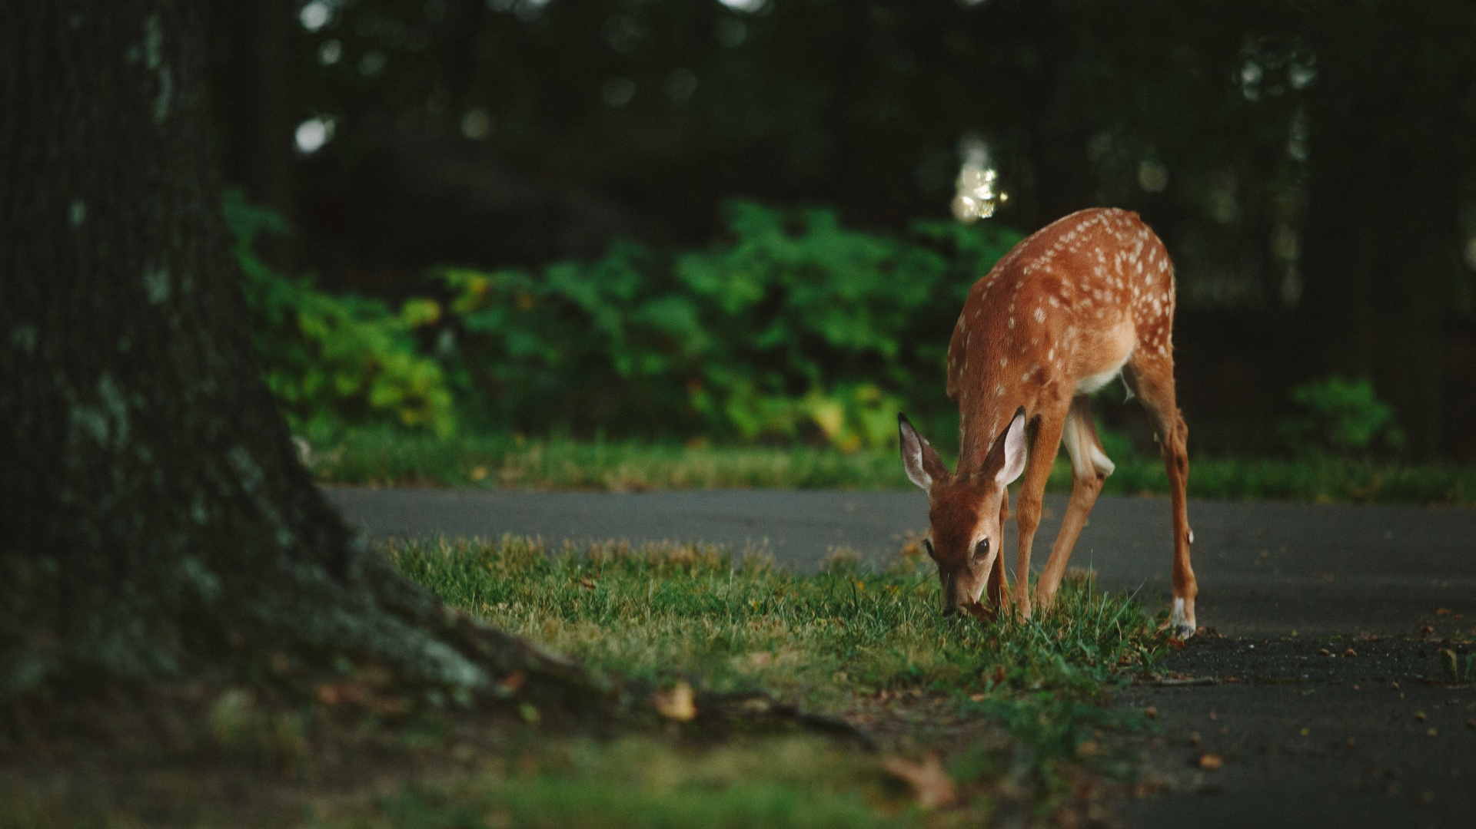
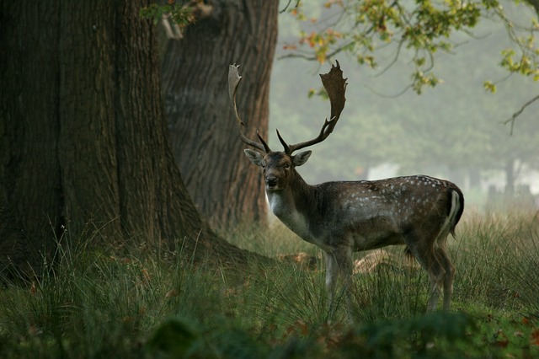
Computer Vision Problems
Focus of this talk
Image Classification
Is there a deer in the image?
Image Similarity
Which images are similar to the query image?
Object detection
Where in the image is the deer?
Image segmentation
Where exactly is the deer?
Coming soon to CNTK
Yes
Query image
Similar image
Solutions available in the Microsoft Cognitive Toolbox (CNTK)

Slide 9
Image Classification

Slide 10
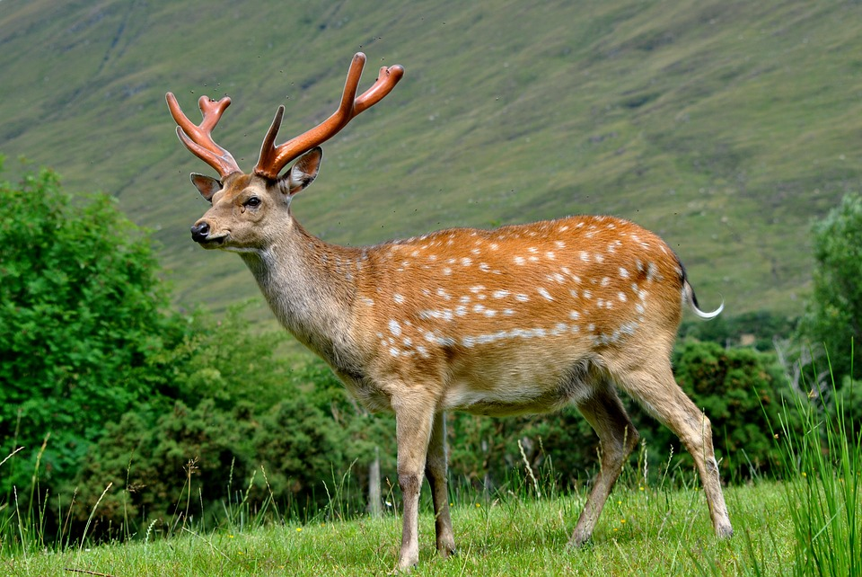
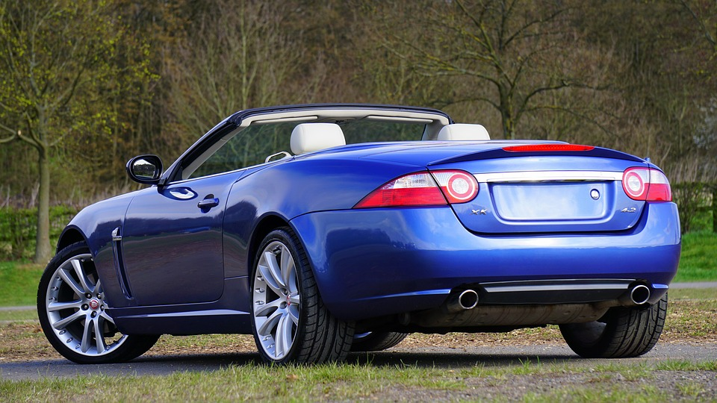
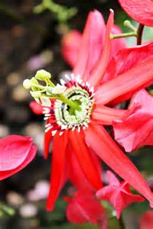
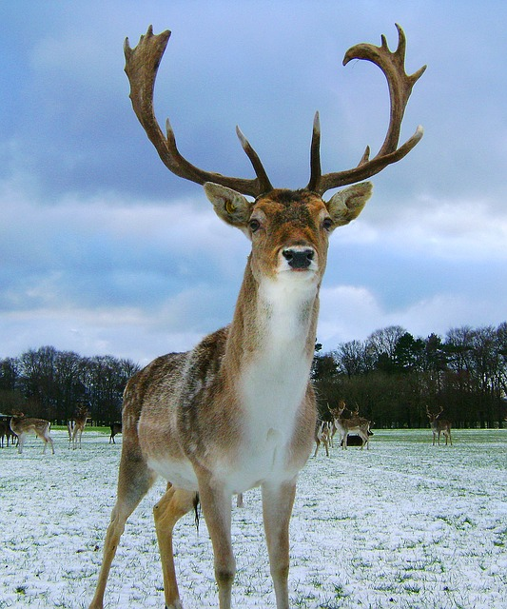
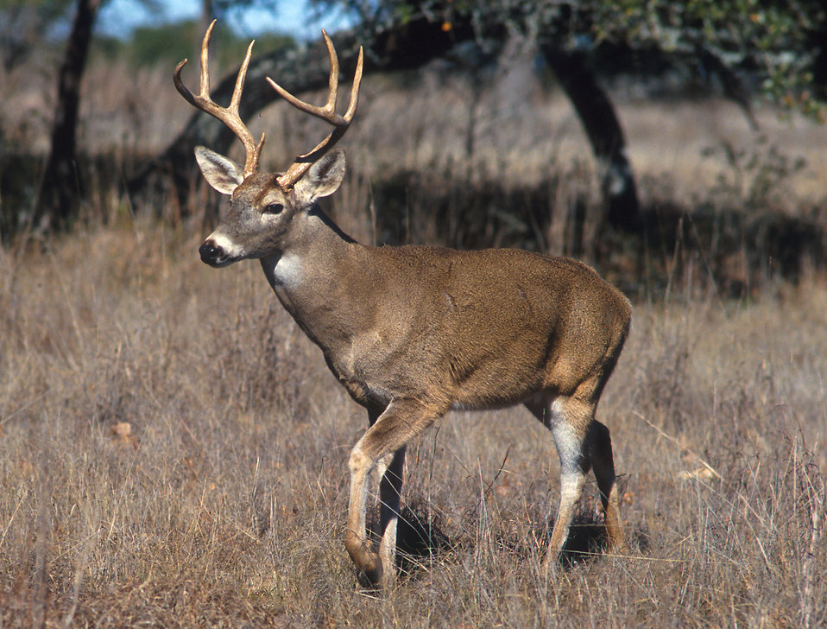

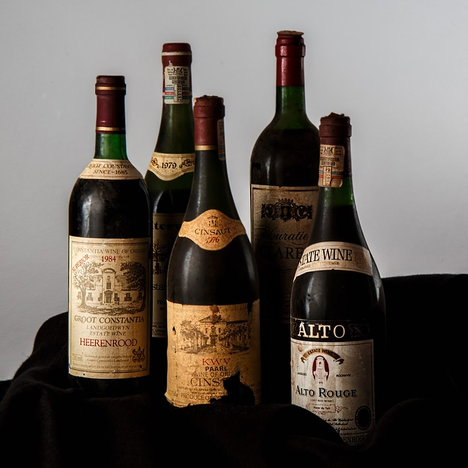
Image classification
Deer classifier:
Build a system to recognize if a deer is in the image
Before 2012: hard-code manual rules that a deer has legs + eyes + etc (e.g. Pictorial Structures)
Deep learning: use positive and negative training examples to learn these rules automatically
Positive training examples
Negative training example

Slide 11
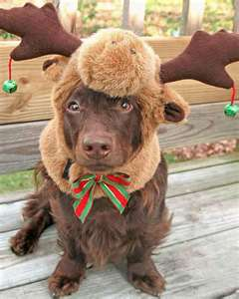

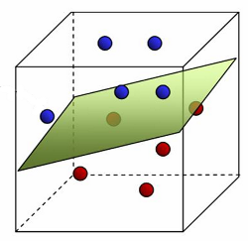
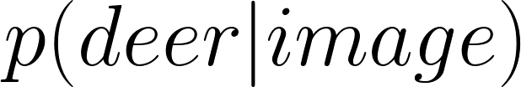
DNN Featurizer
Use a state-of-the-art Deep Neural Network, such as ResNet architecture
Pre-train DNN on ImageNet (contains millions of images with ground truth labels)
Option 1: Keep DNN fixed, classification using SVM g simple, no GPU required, often good accuracies
512 floats
Input image
Featurization using a deep NN
Binary SVM classifier

Slide 12
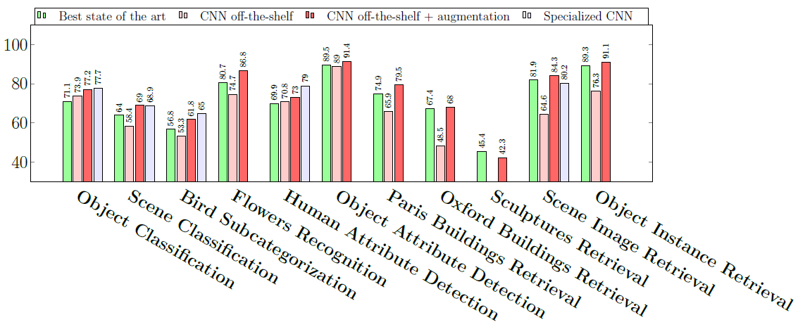
Published results
Many papers looking into options 1 and 2, e.g.: “CNN features off-the-shelf: an astounding baseline for recognition” by Razavian et. al. [2014]
Using a pre-trained DNN shown to achieve very good results in a large variety of tasks
High accuracy especially if images are similar to ImageNet
Competitive results from [1] using a pre-trained DNN without retraining (option 1)

Slide 13
DNN Featurizer
Option 2: add classification to DNN and retrain full network using new dataset
g Pro: improvement in accuracy especially if the task-specific images are very different from ImageNet and without the needing a large number of training examples.
g Con: GPU, much slower to train, requires expert knowledge
Input image
Featurization and classification using a deep NN

Slide 14
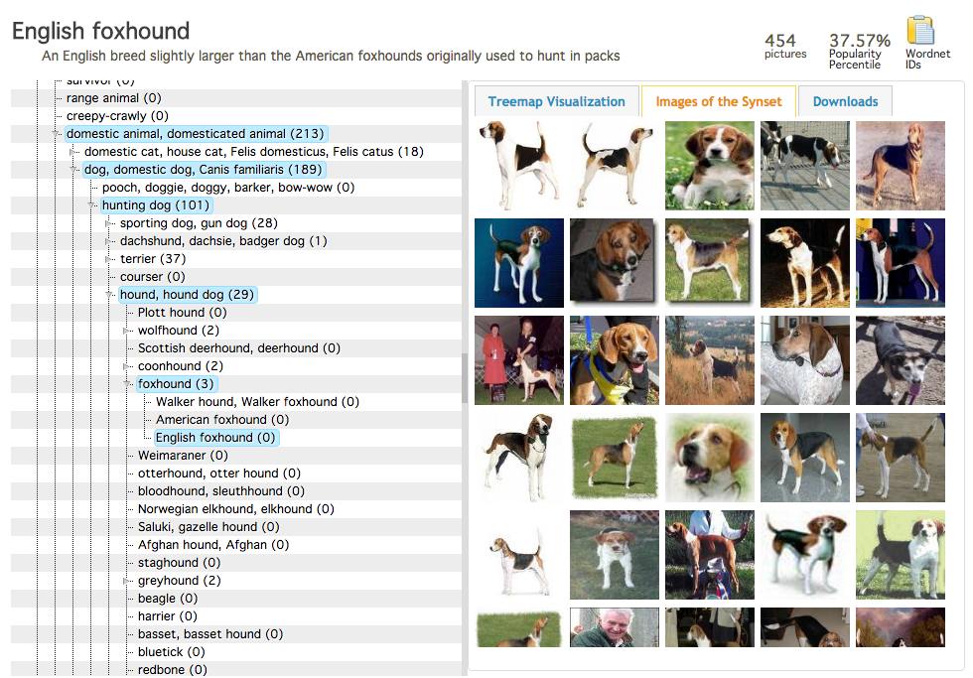

ImageNet dataset
Research dataset with >10 million images
Each image annotated with exactly one label (of the main object in the image)
Wide range of labels, e.g. 101 different hunting dog breeds
ImageNet taxonomy with example images for “English foxhound”

Slide 15
Image Similarity

Slide 16
DNN Featurizer
Pipeline from image classification
512 floats
Input image
Featurization using a deep NN
Binary SVM classifier

Slide 17
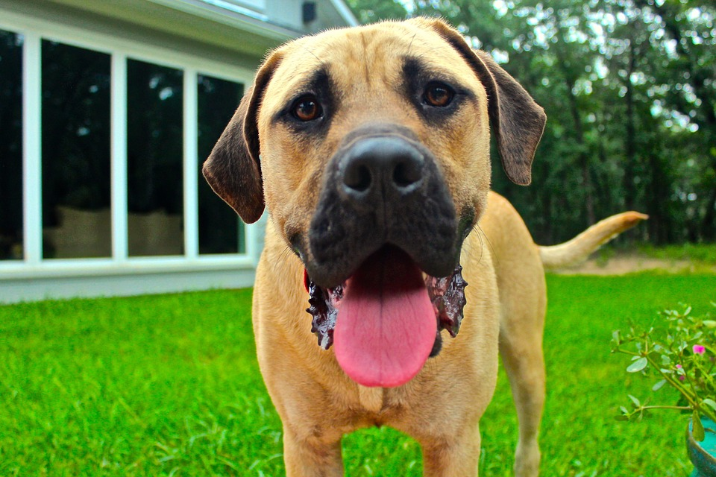


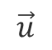
Similarity between two images
Same DNN
$$\vec{u}$$
512 floats
Distance ($\vec{u}$, $\vec{v}$)
$$\vec{v}$$
Possible distances:
L1/L2 distances
Correlation
Cosine similarity
Machine Learned distance (using a SVM)
512 floats
Input image
Featurization using a deep NN
Binary SVM classifier

Slide 18
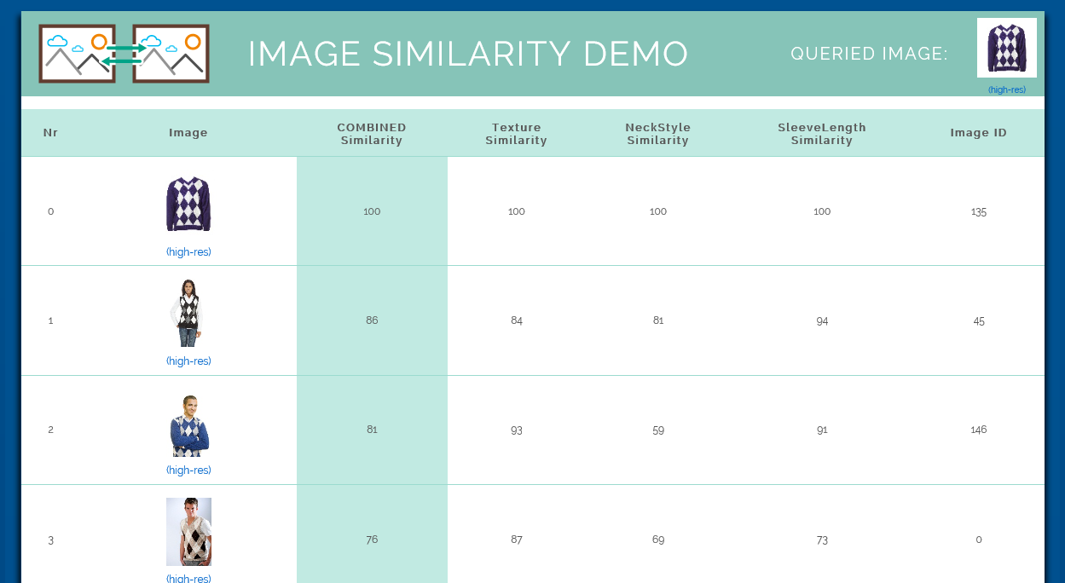
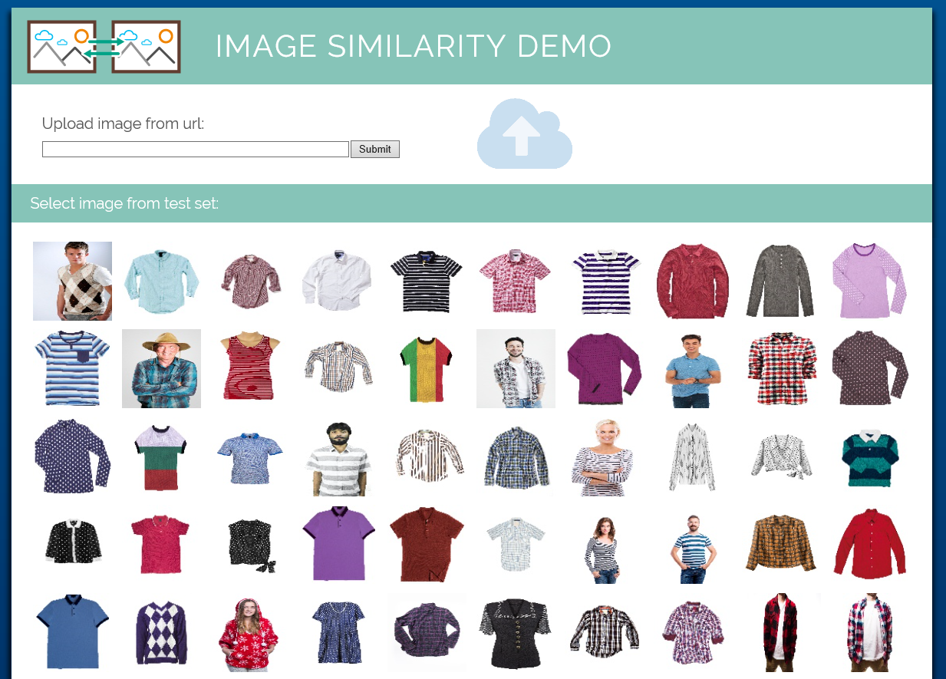
Demo
Query image
Individual similarities for texture, neck style, and sleeve length
Published image ranking website

Slide 19

Demo
Tutorial how to train own image similarity ranker: https://github.com/azure/ImageSimilarityUsingCntk

Slide 20
Object Detection

Slide 21
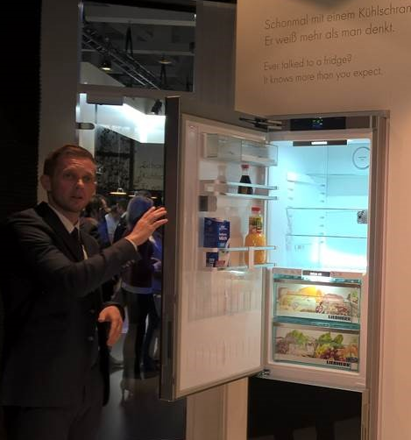
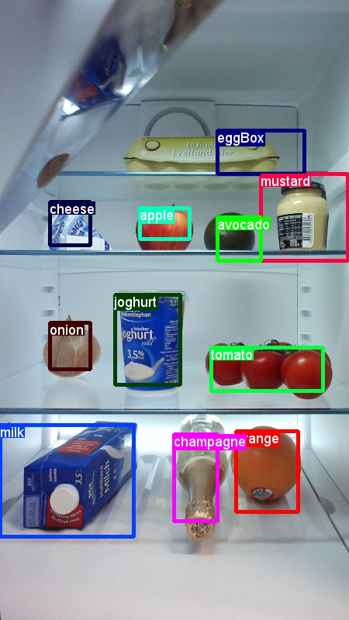
Overview
Technology: Used CNTK ‘s Fast R-CNN object detection.
Customer: Liebherr, finding grocery items in refrigerators. Demoed at the IFA fair in Berlin.
Productization: Rest API published using Azure Flask.
Tutorial on Github: How to train own object detector (2nd part of this presentation).
Demo setup at IFA Berlin.
Example detections.

Slide 22
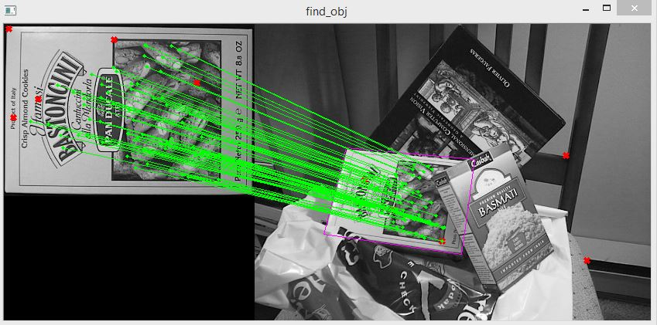
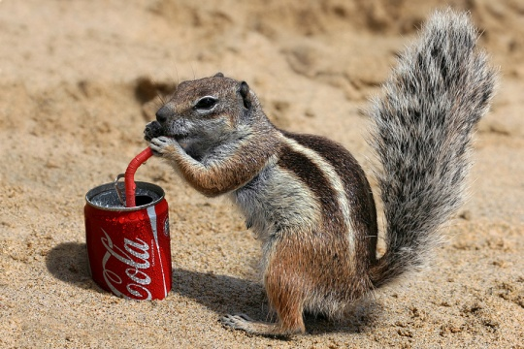
Popular object detection approaches
Approach in this presentation
Key point based
E.g.: SIFT/ORB
Mainly for planar objects however at different angles, rotations, or occlusions
Very high precision at moderate recall
Sliding window based
E.g.: Histogram of Orientated Gradients (HoG)
Mainly for objects which have a small appearance variety
High recall + fast
Deep NN based
E.g. Fast R-CNN in CNTK
Cutting edge technology
Works well in a large range of settings
Requires large dataset for training

Slide 23
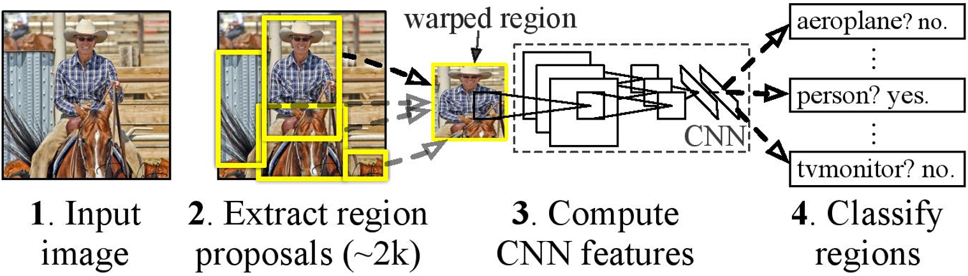
R-CNN pipeline
Network pre-trained on millions of images.
Output: 4096 floats per region
Basic idea of the original R-CNN work. Plot taken from paper: “Rich feature hierarchies for accurate object detection and semantic segmentation”, Ross Girsheck et. al., CVPR 2014

Slide 24
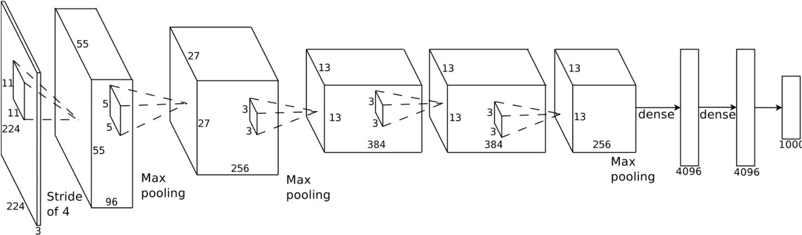
This works – but it’s slow!
Input: Regions of Interest
State-of-the-art results, but very slow since the full network needs to be evaluated for each single ROI.
Follow-up paper “Fast R-CNN”: compute convolution layers only once per image:
Perform for each ROI
ROI Pooling
O
Output: detection scores for each ROI
Input: image
1000
O
O
O
21
1000
O
Modifications to transform a pre-trained Alexnet model into a Fast R-CNN model for object detection.

Slide 25
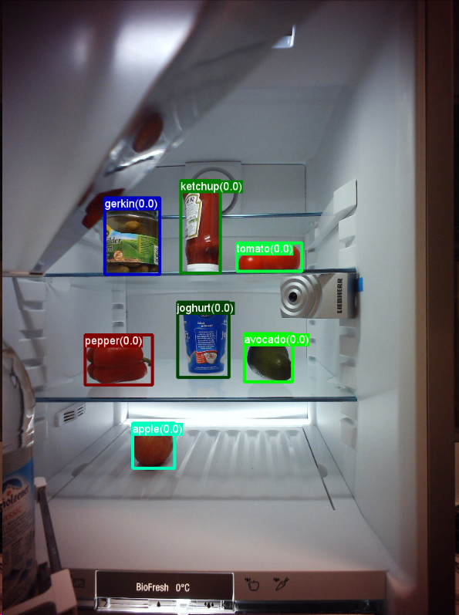
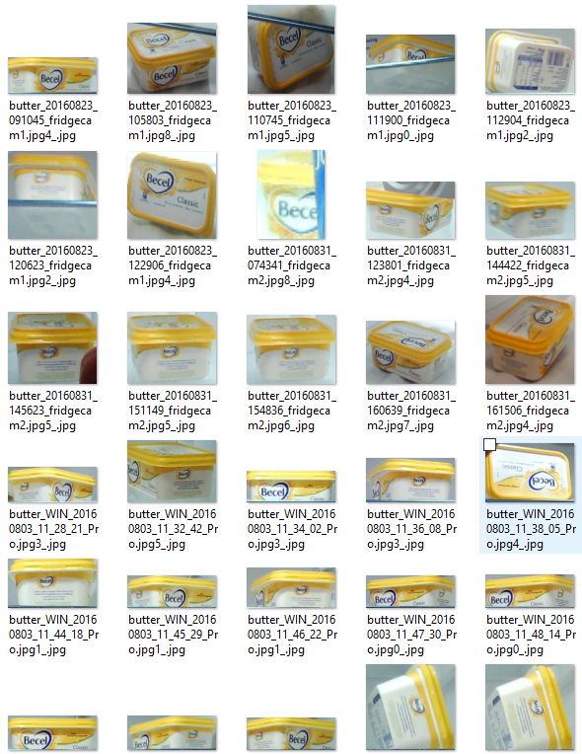
Preliminary dataset
Preliminary dataset: annotated 311 images, split into 71 test and 240 training images.
In total 2578 annotated objects, i.e. on average 123 examples per class.
Supplied additional 1245 negative images (via hard-negative mining).
21 different objects: "avocado", "orange", "butter", "champagne", "cheese", "eggBox", "gerkin", "joghurt", "ketchup", "orangeJuice", "onion", "pepper", "sausage", "tomato", "water", "apple", "milk", "tabasco", "soySauce", "mustard“ and "beer“.
Ground truth annotated training image.
Training examples for object “butter”.

Slide 26
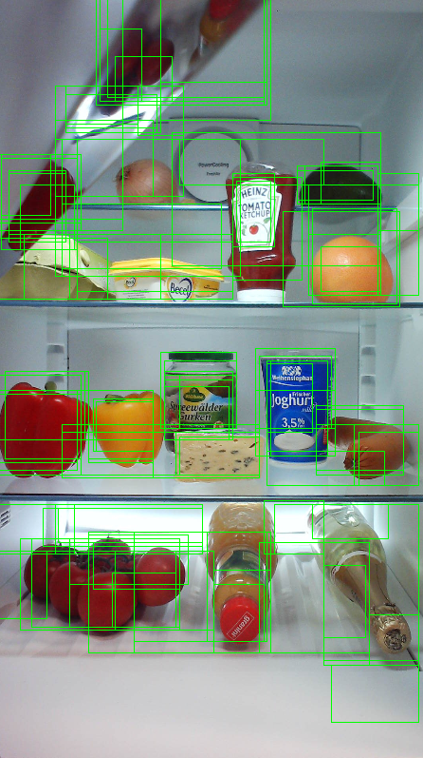
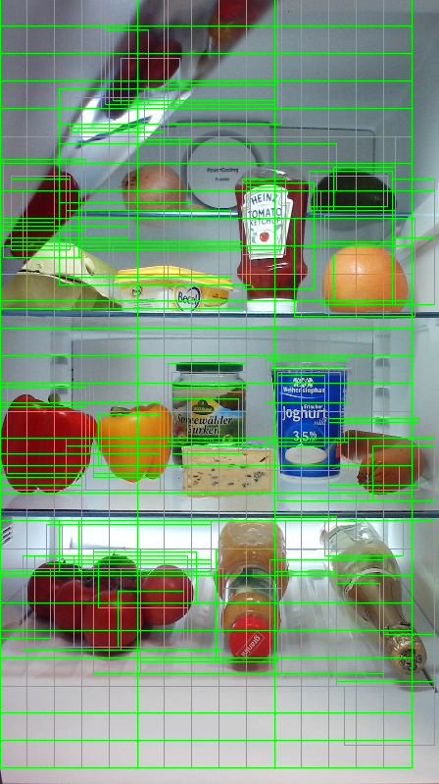
ROI generation
Tight ROIs from selective search.
Added ROIs on grid at different aspect ratios.
Uses a method called “selective search” to obtain regions-of-interest (ROIs).
Traditional Computer Vision method, does not require any training.
Additional ROIs using a simple grid search at multiple scales and aspect ratios.
Remove ROIs that are too big, too small, with wrong aspect ratio, etc.
Tweak parameters for speed and good overlap with ground truth annotations.
Image with ROIs generated using (left) selective search and (right) additional ROIs from grid sampling.

Slide 27
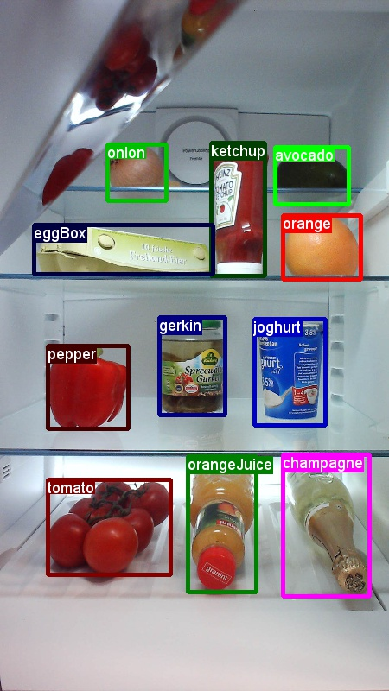
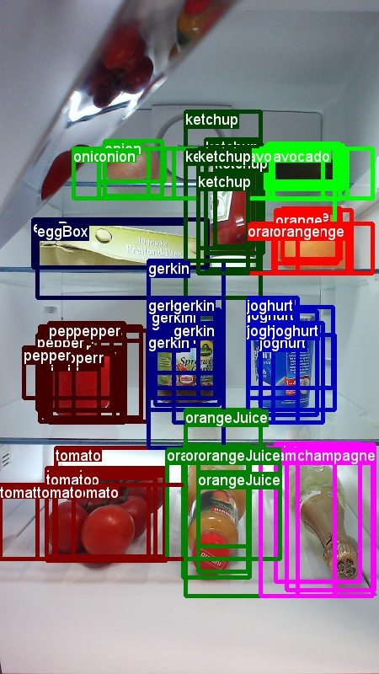
Training data
Positive training examples:
Use ground truth as training examples
Add Regions-of-interests (ROIs) which overlap with the ground truth annotations
Negative training examples:
All other ROIs
Positive training examples given by the ground truth annotation.
Adding Regions-of-Interest (ROIs) which are similar to the ground truth annotation.

Slide 28
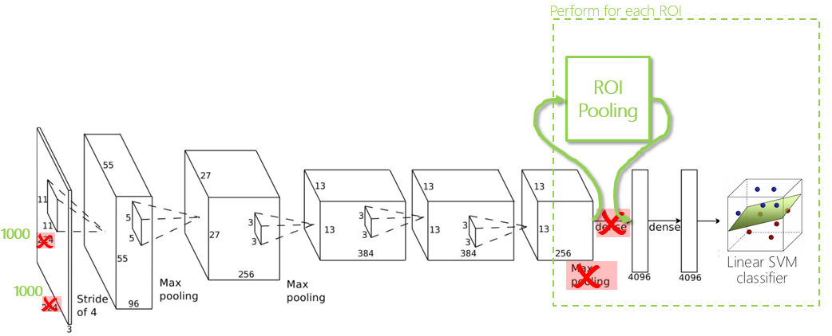
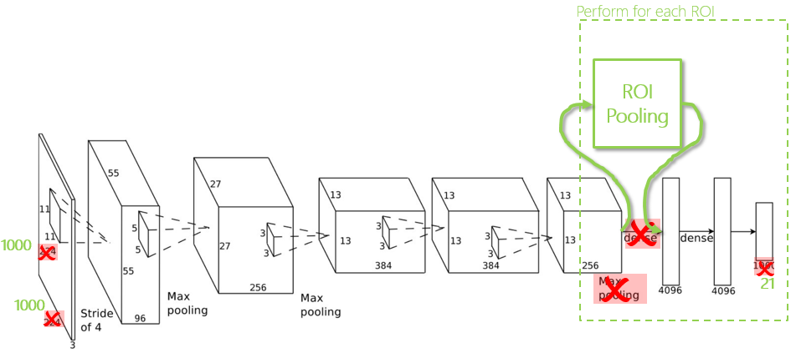
Classifier training
Alternatives:
Option 1: Keep DNN unchanged, and train SVM on output of last fully-connected layer.
Option 2: Add final classification layer to the DNN and retrain the network. → Potentially better accuracy, but more difficult to train and requires GPU.
Option 1: train SVM on DNN output.
Option 2: add final classification layer to DNN and retrain.

Slide 29
Results

Slide 30
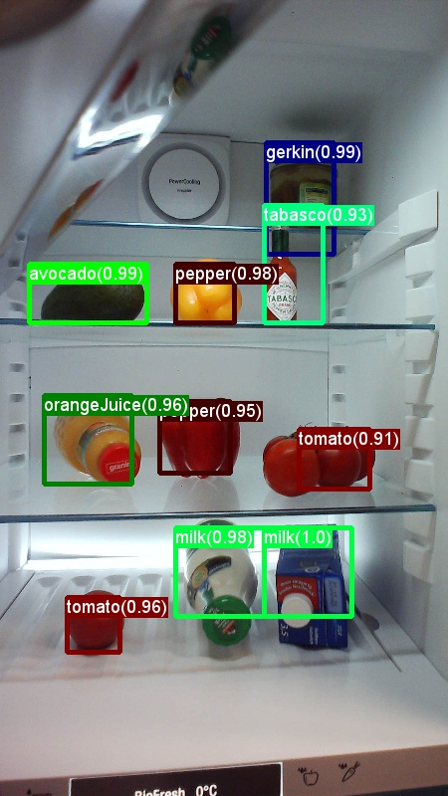
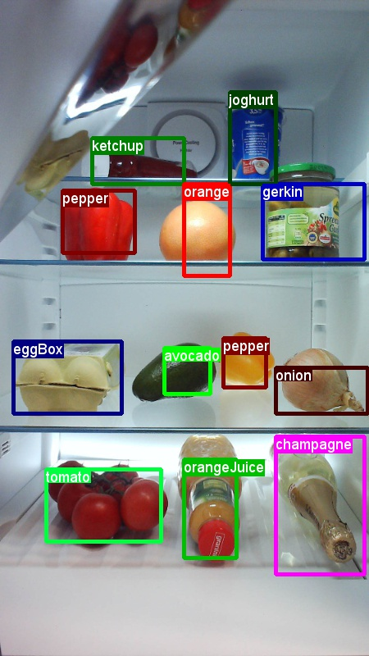
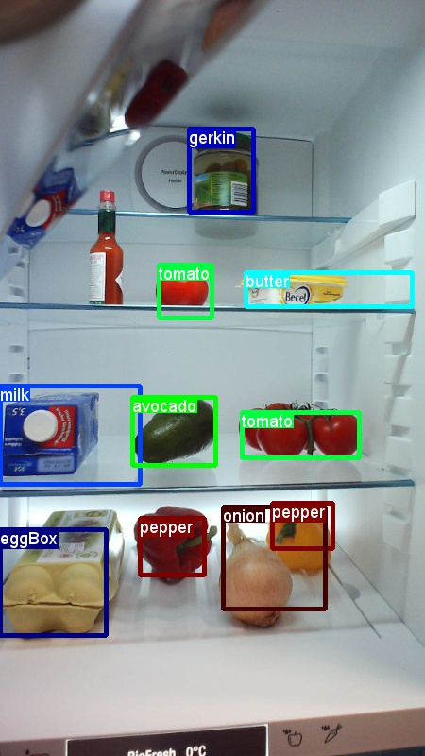
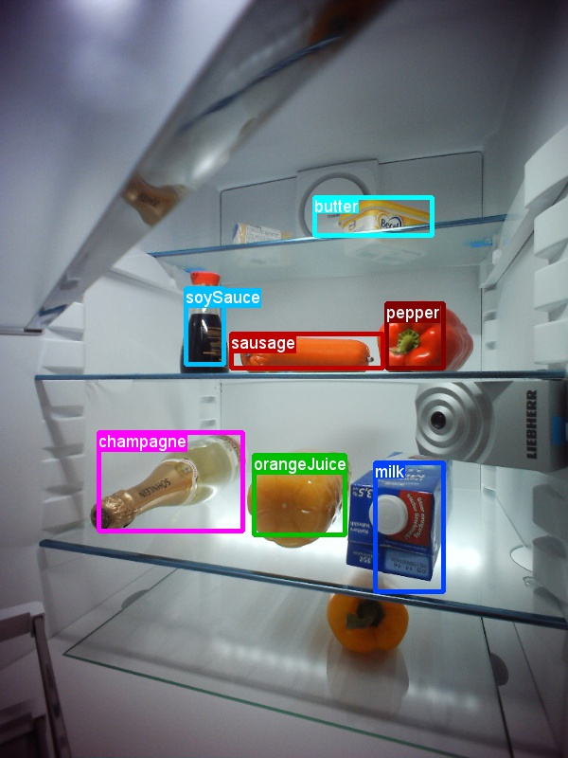
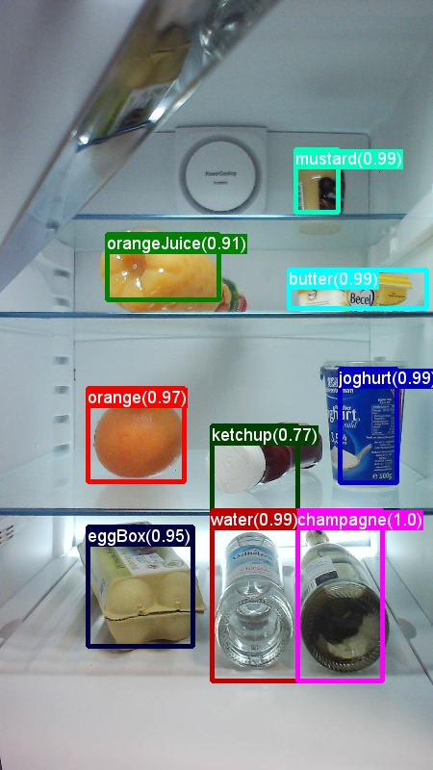
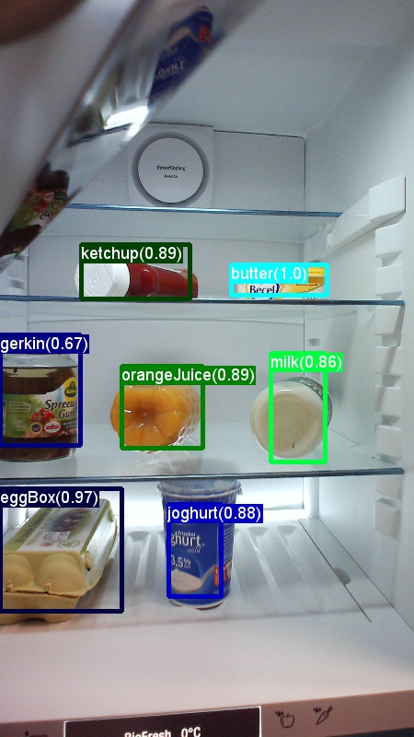
Results
Using the preliminary dataset with only 311 images
Final classifier has a precision of 98% at a recall of 80%
Representative results:

Slide 31
Results on Pascal VOC
Comparison to Pascal VOC:
Popular dataset for comparing object detection approaches.
In total ~11500 training and ~6000 test images with ground truth annotations.
20 different objects: 'aeroplane', 'bicycle', 'bird', 'boat', 'bottle', 'bus', 'car', 'cat', 'chair', 'cow', 'diningtable', 'dog', 'horse', 'motorbike', 'person', 'pottedplant', 'sheep', 'sofa', 'train', 'tvmonitor'.
Version | Mean Average Precision (mAP)
R-CNN Paper | 0.52
Our work (CNTK) | 0.51 (without extensive parameter tuning)
Comparison of our work to the published results (without bounding box regression)
Notes:
Explain mAP—mean of average precision across 21 classes in the dataset
AP—like precision (how many of the boxes you predicted are this class are actually this class?) but also takes into account the ranking of the boxes. It’s worse if you’re wrong when the algorithm was very sure and gave the box a high confidence score than when the box has a low confidence score.
4 point off but lots of stuff we could be doing better

Slide 32
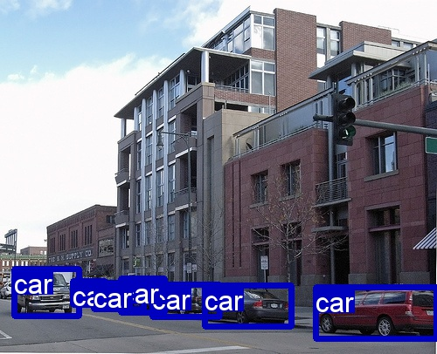
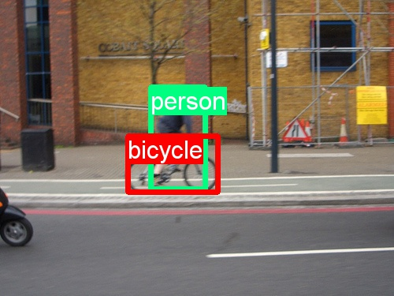
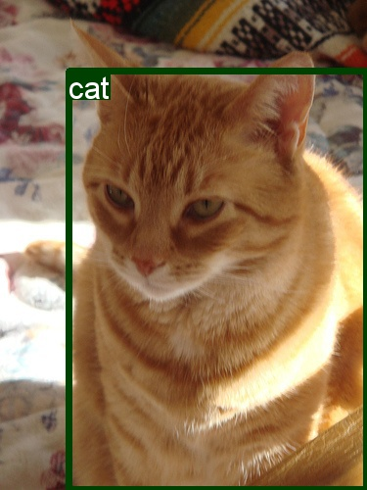
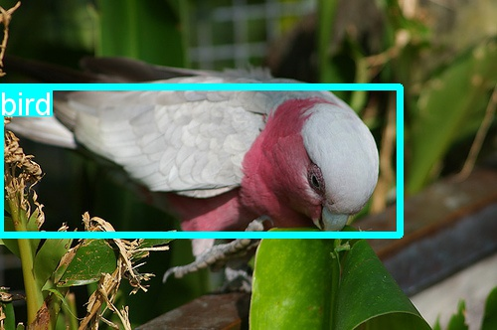



Slide 33







Slide 34
Demos

Slide 35

Demo
Tutorial how to train own object detector: https://github.com/azure/ObjectDetectionUsingCntk

Slide 36


Demo
Published Rest API and visualization on Azure

Slide 37
Demo
Object detection solution

Slide 38
Takeaway slide
Add content

Slide 39
Questions ? (pabuehle@Microsoft.com)

Slide 40
Appendix

Slide 41
This works – but it’s slow!
Perform for each ROI
ROI Pooling
O
1000
O
O
O
Linear SVM classifier
21
1000
O

